Slide 1
Chapter 6: Section 1 Review
What led to the nation’s oil boom?
What was the Bessemer process and how did it fuel steel production?
What were some of the new uses in the US for steel?
How did harnessing of electricity transform American business?
How did new inventions and products affect people at home and at work?

Slide 2
Chapter 6: Section 2 Review
How did the government facilitate the expansion of the railroads?
What were the positive and negative aspects of railroad expansion?
How did railroad time work?
How did growth of railroad lines promote the growth of cities and trade?
How was the town of Pullman different from other towns?
What was the Credit Mobilier scandal?
Why were the farmers upset with railroad companies?
How did the Granger laws help farmers?
What was the Interstate Commerce Act?

Slide 3
Chapter 6: Section 3
What business did Andrew Carnegie dominate?
What was the difference between vertical integration and horizontal integration?
What does the theory of Social Darwinism advocate?
What methods did ruthless business operators use to eliminate their competition?
Why did the nation’s business boom bypass the South?
What conditions did many factory workers face in the late 19th century?

Slide 4
Age of Big Business
Thanks for coming in…

Slide 5
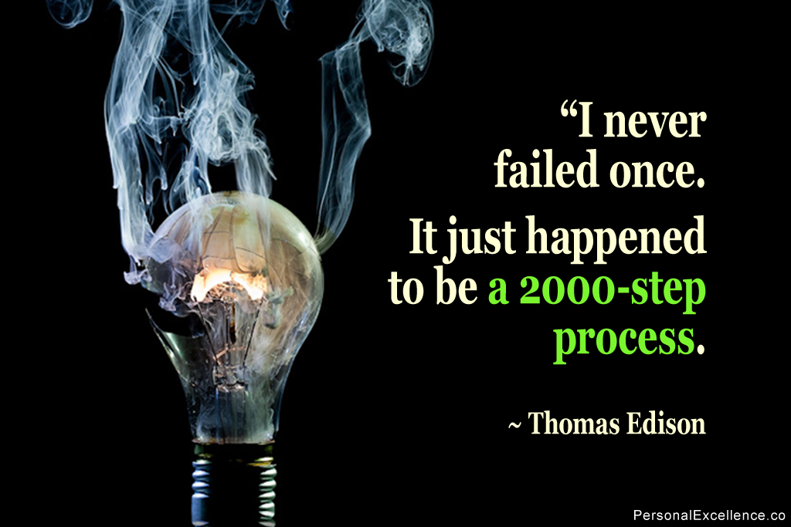
Thomas Alva Edison
Ear infections & scarlet fever gave him horrible hearing
Public school for a total of 12 weeks.
A hyperactive child, prone to distraction, he was deemed "difficult" by his teacher.
Home schooled
The Grand Trunk Herald
Chemical experiments
At 13, saved 3-year-old life
Learned telegraph

Slide 6
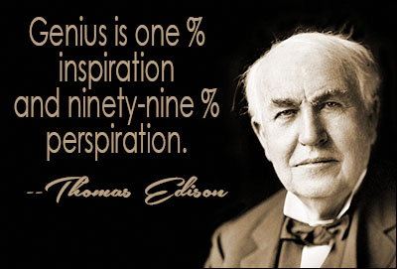
Thomas Alva Edison
At 22, he was paid $44,000 for his invention of a new stock ticker on the NYSE
Quit telegraph to be full-time inventor in NYC
Invented a device to record sound: phonograph
Light bulb (1880), and founded Edison Illuminating Company to get the electricity distributed (later would become General Electric)
Alkaline Battery
Created the motion picture camera
Koster & Bial's Music Hall in New York City

Slide 7
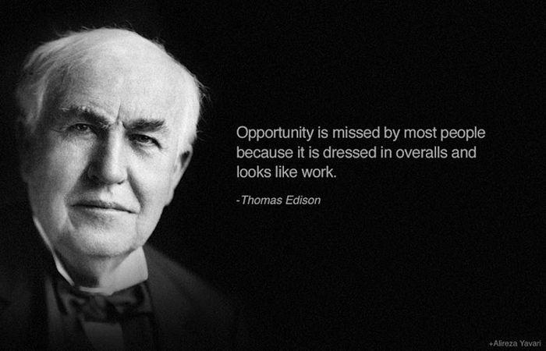
Worked on an electric car, ended up making battery for engine starter for friend Henry Ford
Wouldn’t work for military
Tyrant on employees, neglected family, ruthless to competitors, socially awkward

Slide 8
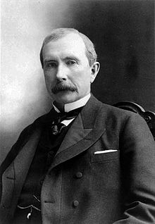
John D. Rockefeller
Seven years old and was in charge of raising and selling family turkeys
Hoed potatoes for 37 cents a day.
Lent the saving back to the farmer
“it was a good thing to let money be my slave, and not make myself a slave to money.”
Standard Oil Co. founder (1870)
First American billionaire
w/inflation richest American in history
Retired 1897
Last 30 years of life spent on philanthropy targeting
Science, education, medicine

Slide 9
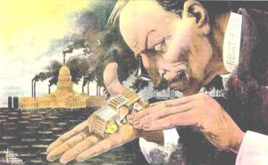
John D. Rockefeller
Formed a trust of 42 “companies” controlling 98% of oil refineries in the US
Founded
University of Chicago
Spelman College
Rockefeller University
Central Philippine
University
Research:
Yellow Fever
Hook worm

Slide 10
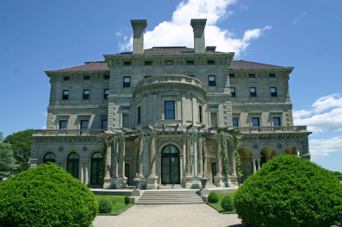
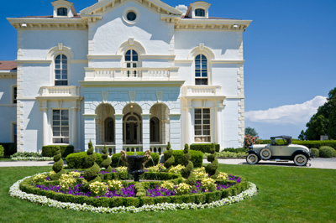
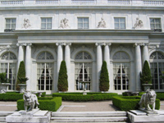
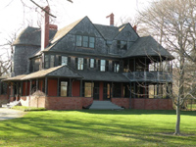
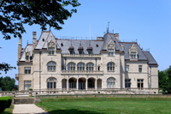
The Gilded Age
refers to the era of rapid economic and population growth in the United States during the post-Civil War and post-Reconstruction eras of the late 19th century (1865-1901)
Mark Twain and Charles Dudley Warner
The Gilded Age: A Tale of Today.
Gilding
meant to ridicule ostentatious display

Slide 11
Railroads: The Iron Beast
1865: 35,000 miles of track in United States
1900: 192,556 miles of track
Government wants more, but there is little profit in initial laying of track
Government motivation for trans-continental railroads
Granted 1 mile square land in a checkerboard pattern around railroad
Government got postal rates low and military traffic
Towns competed for the right to have the railroad cut through their town
Trans-continental railroad
Union pacific Railroad
Irish workers in the East
Fight off Native Americans
Also received $16,000 on flat land to $48,000 on rough terrain
Central pacific Railroad
Chinese from the West
Slow going through the Mountains
Comes together in Ogden Utah in 1869
Union Pacific 1,086 miles
Central pacific 689

Slide 12
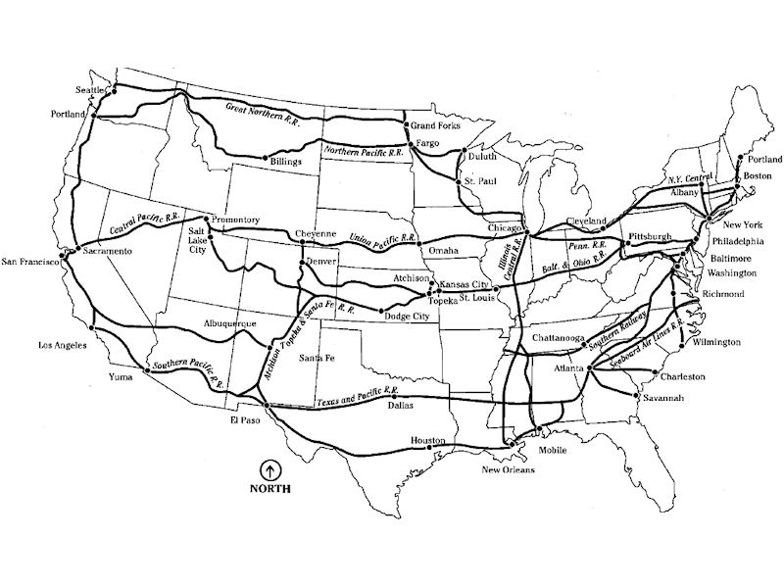
Railroads

Slide 13
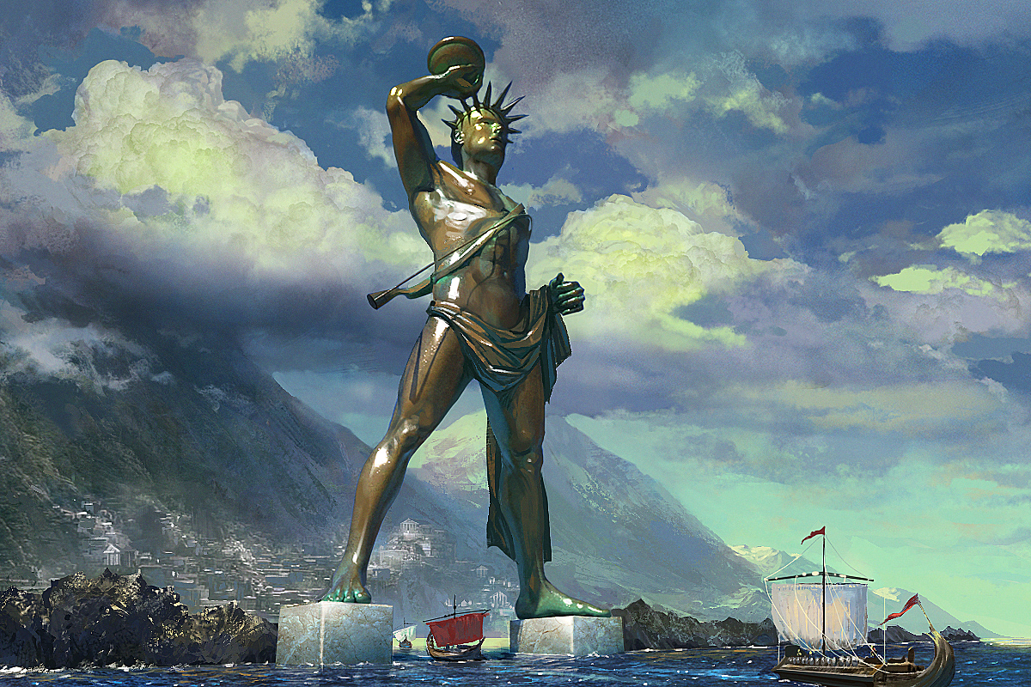
Colossus of Rhodes

Slide 14
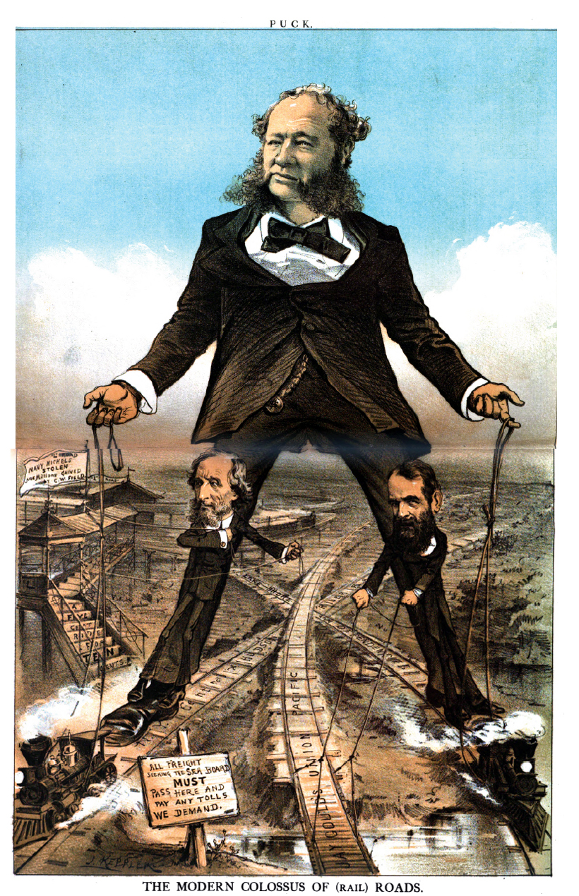
“The Modern Colossus of Railroads”
William Vanderbilt, Jay Gould, and Cyrus W. Fields
Union Pacific,
New York Central,
Lake Shore & Dependence lines
“All freight MUST pass here and pay any tolls we demand”

Slide 15
Political Cartoon Analysis
The title of this cartoon is a pun on the Colossus of Rhodes, a statue erected in 282 BC on an island near Greece. According to legend, the 100-foot-tall statue straddled Rhodes’s harbor entrance. Do you think the artist means the comparison as a compliment or a criticism? Why?
The reins held by the railroad magnates attach not only to the trains but also to the tracks and the railroad station. What does his convey about the magnates’ control of the railroads.

Slide 16
Discuss
Make a list of things that the Trans Continental railroad allowed Americans to do (better).
Who benefited from the growth of Railroads?
Who was hurt by it?
What enabled America go grow in power militarily, economically and socially in the post-Civil war era?

Slide 17
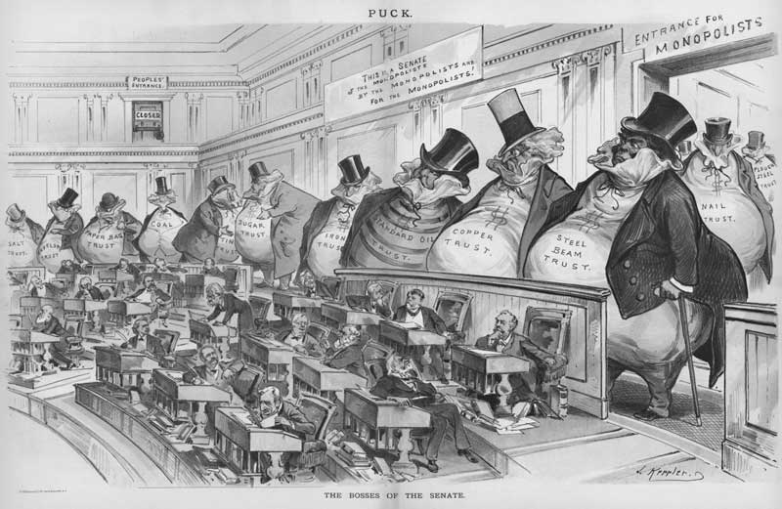
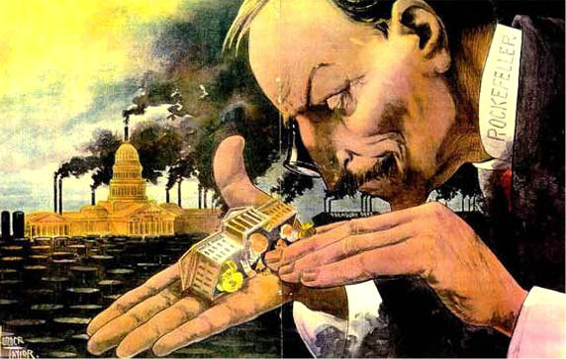
Factors Leading to the Growth of Big Business
Rise of Heavy Industry
Technological Boom
Phones
Kerosene then gasoline
Electricity (Power plants)
Bessemer Process
photography
Natural Resources
Much Needed Labor Supply
Laissez-Faire Economics
describes an environment in which transactions between private parties are free from state intervention, including restrictive regulations, taxes, tariffs and enforced monopolies.

Slide 18
Chapter 6: Section 3 (cont…)
What did labor unions advocate?
What different types of unions emerged during the nation’s industrial boom?
What were the reasons for the various strikes during the 19th century?
What role did women play in the labor movement?
How did management and the government react to union activity?

Slide 19
Capitalism v Socialism
Capitalism:
an economic system in which resources and means of production are privately owned and prices, production, and the distribution of goods are determined mainly by competition in a free market
Adam Smith:
Laissez Faire (let alone)
Pros:
creates more wealth than any other possible economic system, and that its benefits are mainly to the ordinary person, new ideas
Cons:
Associated with economic instability and an inability to provide for the well-being of all people

Slide 20
Capitalism vs. Socialism
Socialism:
Collective, or governmental ownership, and administration of the means of production and distribution of goods
Karl Marx and Frederick Engels
Beginning steps in reaching Communism
Pros:
More social, economic, medical, political equality
Cons:
Higher costs, not perfectly equal, fewer new ideas, big government

Slide 21
Capitalism vs. Socialism
Create a chart
Government Regulation?
Competition?
Drive or work ethic?
Retirement?
Taxes?
Health Care?
Promoting of new ideas?
Choice for consumer?
Economic Gap between rich and poor?
Employment?

Slide 22
Monopolies vs. Trusts
Monopoly:
exists when a specific person or enterprise is the only supplier of a particular commodity
Legal v. illegal
Phone, electric, water, cable
Trusts:
Multiple people, or companies, band together to control prices and prevent new competition

Slide 23
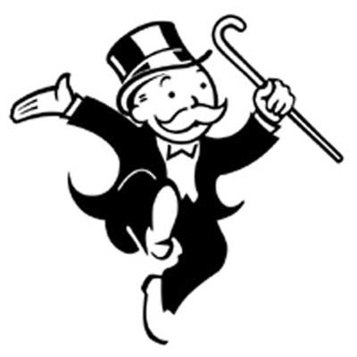
Robber Baron or Captains of Industry
Robber Baron Characteristics:
Gained wealth through unfair and uncompetitive business practices
Dominant in respective industry
Suits, top hats and walking sticks
Uncle Penny Bags
Captains of Industry Characteristics:
Having benefitted society with
increased productivity
expansion of markets
providing more jobs
or acts of philanthropy

Slide 24
Create an Ode to the Robber Barron
Cornelius Vanderbilt
Andrew Carnegie
J.P. Morgan
John D. Rockefeller
Include:
1) Evidence of Robber Barron or Captain of industry
2) Knowledge of their industry
3) Justification of wealth (pg 550)
Choose 2 of the following between
Poster
Poem
Song
Speech
Letter of Recommendation to get into the Rich Guy hall of fame

Slide 25
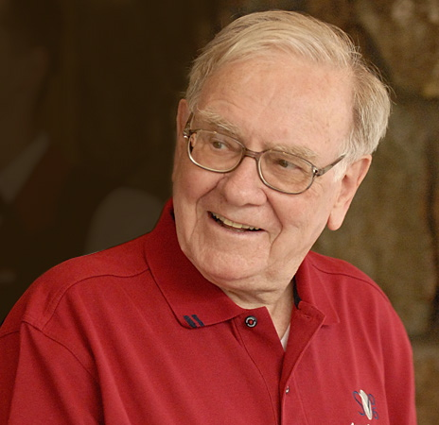
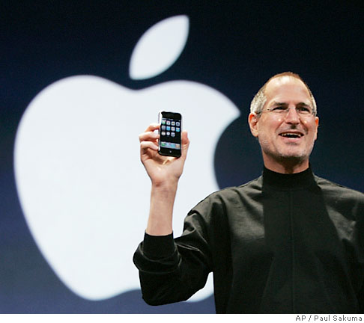
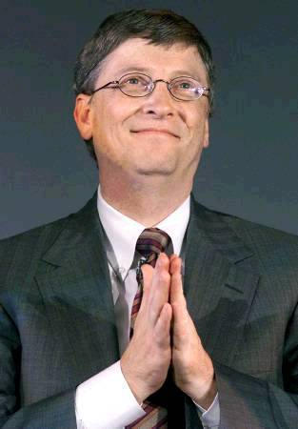
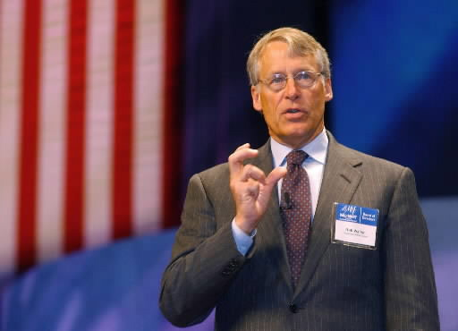
Robber Baron or Captain of Industry?

Slide 26
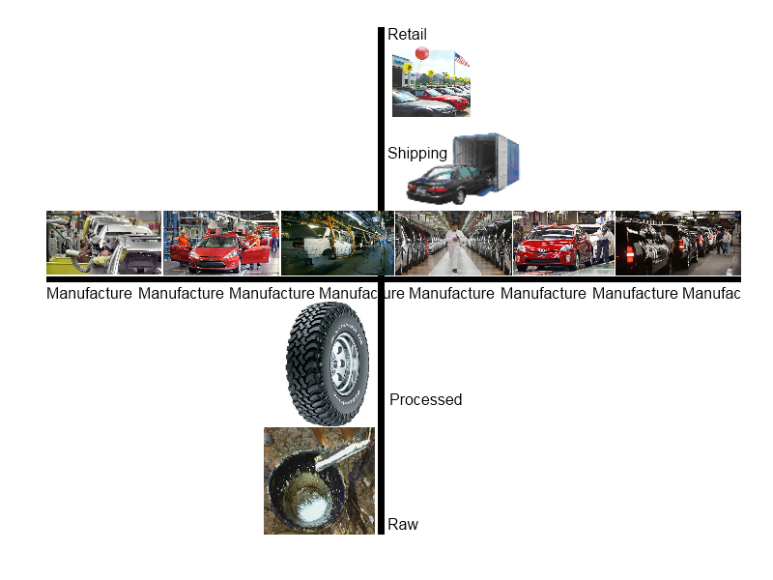
Horizontal v. Vertical Integration

Slide 27
Gospel of Wealth
“godliness is in league with riches”
“the good Lord gave me my money”
Moral obligation to give back too…
Social Darwinism
Self-justification for the wealthy, leads to contempt for the poor
Those who are poor are lazy and lack drive
Relates back to basic tenants of capitalism

Slide 28
Why were they successful?
New untapped markets
New advances
Ingenuity
Unscrupulous
Little governmental regulations
Immigrants for cheap labor

Slide 29
Assignment
Create an Ode to the Robber Barron
Cornelius Vanderbilt
Andrew Carnegie
J.P. Morgan
John D. Rockefeller
Include:
1) Evidence of Robber Barron or Captain of industry
2) Knowledge of their industry
3) Justification of wealth (pg 550)
Choose 2 of the following between
Poster
Poem
Song
Speech
Letter of Recommendation to get into the Rich Guy hall of fame

Slide 30
Corruption
Stock watering:
Originally for selling cows. Salt and water made them seem better in pictures so people bought
Purposefully deceiving in making an investment seem better than it is in order to sell stock.
Taking bribes to make the railroad go past your town
Paid politicians, judges, police

Slide 31
HOMEWORK:
1. Jay Gould
2. Boss Tweed
3. Credit Mobilier
What was their crime?
Who did it hurt?
Should it be illegal?
Can it happen today?
What if anything is stopping it?

Slide 32
Is Government Necessary?
Sherman Anti-Trust Act
prohibited certain business activities that federal government regulators deem to be anticompetitive
Had legal loopholes and no real “teeth.”
Was used against labor unions instead
First time government could really interfere with private industry
Interstate Commerce Act
required that railroad rates be "reasonable and just," but did not empower the government to fix specific rates.
railroads publicize shipping rates and prohibited short haul or long haul fare discrimination, a form of price discrimination against smaller markets, particularly farmers.
Created Interstate Commerce Commission (ICC), which it charged with monitoring railroads to ensure that they complied with the new regulations

Slide 33
Supreme Court Decisions
Interstate Commerce
Wabash, St. Louis & Pacific Railway Co v. Illinois, 1886
Government’s Role in Interstate Commerce
United States v. E.C. Knight Co., 1895
Federal Control of Interstate Commerce
In re Debs, 1895

Slide 34
Labor Unions
Skilled vs. Unskilled
Corporation vs. Individual
Wealth
Lawyers
Press
Politicians
Strikebreakers (scabs)
Thugs
“I can hire one-half of the working class to kill the other half.”
Federal courts
Company towns

Slide 35
Thanks for coming in…
What are the characteristics of a robber baron? Give an example.
What are the characteristics of a captain of industry? Give an example.
What were the five factors that led to the Age of Big Business?
Why is this time period often referred to as the Gilded Age?

Slide 36
Essay Question
Make a list of the combination of factors that produced the growth and industrialization of the American economy in the late 19th century. Pick the two factors you think were especially important and explain why.

Slide 37
Labor Unions
National Labor Union
600k
Skilled, unskilled, and farmers
No women, Chinese, black
Knights of Labor
“an injury to one is the concern for all”
EVERYONE
8 hour work day

Slide 38
Labor Unions
Haymarket Square Bombing
Bomb thrown
5 sentenced to death for being associated with it
Ruined K.of.L. reputation
Public was sick of hearing about
American Federation of Labor
New group, just of skilled labor
Samuel Gompers
“we don’t patronize”
Walkouts
War chest of funds

Slide 39
Labor Unions
What groups make up labor unions today?
What are the positives of labor union?
What are the negatives?

